Slide 1

Project Summary
https://github.com/hanghu/HomeIn
Members: Hang Hu, Yang Jiang, Mengyuan Liu, Joe Puleo

Slide 2
I find a house on the market and I like it.
Should I buy it?

Slide 3
Primary Users: General Public
What information does the public want before buying a house?
Comparative Market Analysis - “the Comps” based on past sales
Price
House specifications
Bedrooms, Bathrooms
Size in square feet
Year built
Area safety concerns (Crime rates)

Slide 4
Use Cases
How can the public best access and interact with housing and crime data?
Map visualization interface (King County)
→ Layer 1:
Individual selectable markers with desired house prices and specifications (i.e. Bedrooms, square feet, year built, etc.)
→ Layer 2:
Heatmap of crime rates
→ Layer 3:
Choropleth map of house prices within each zip code

Slide 5
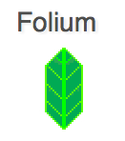





Package Dependencies

Slide 6
Data Mining Solutions
Package Focus: Geopy, Pandas, Numpy

Slide 7
Raw Datasets
House Rate
Crime Rate

Slide 8
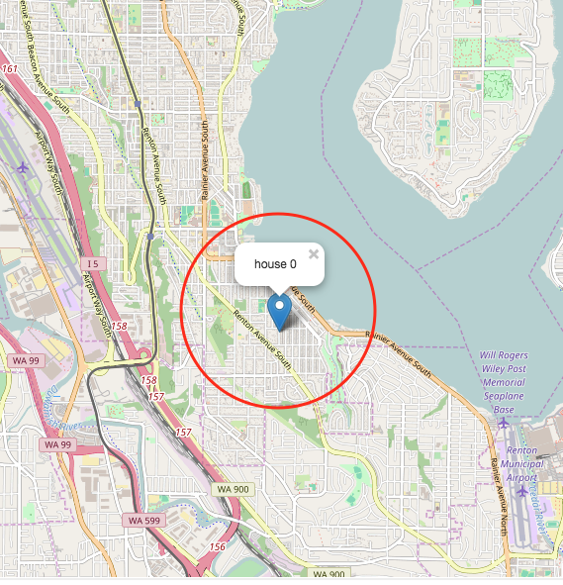
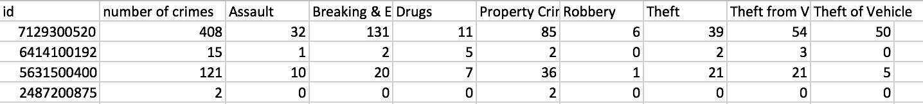
Crime Data Preprocessing
How many crimes happened around a house in the past a few years before it’s sold?
What are the types of the crimes? And how many of them for each type?
We set year range as past 5 years and the distance range as 1.0 mile

Slide 9
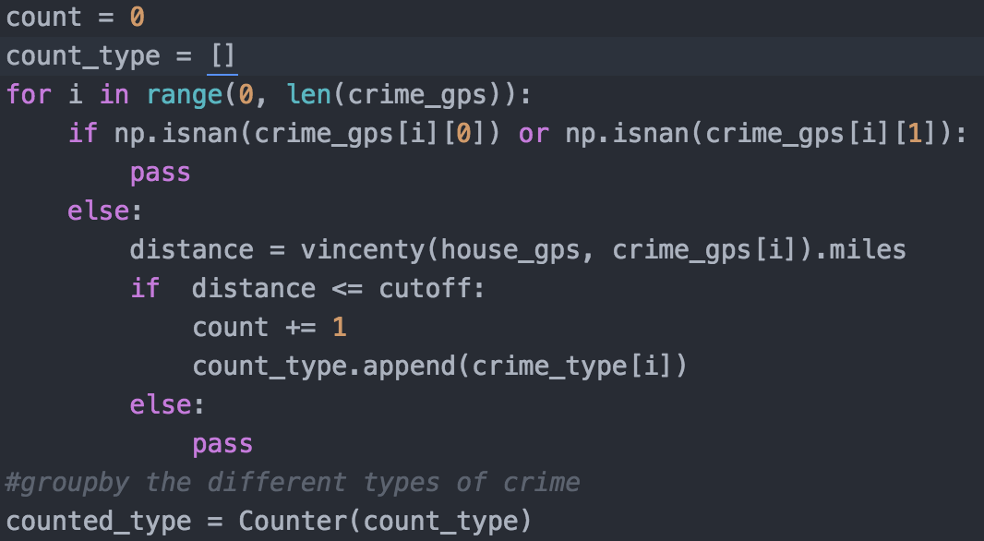
Crime Data Preprocessing: crime_info.py
Use geopy package to calculate distance based on house and crime GPS coordinates
Count and group crimes by their type, for those distance smaller than cutoff distance (default=1.0 mile)
vincenty function from
geopy package, which takes two set of GPS coordinates as input, and outputs distance with unit of miles

Slide 10
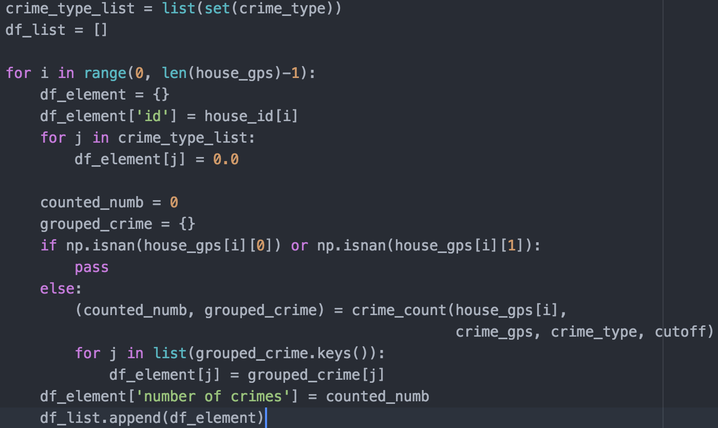
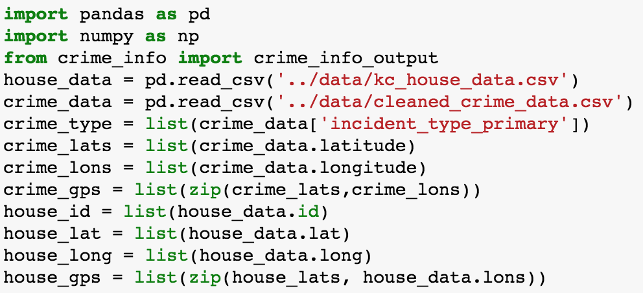
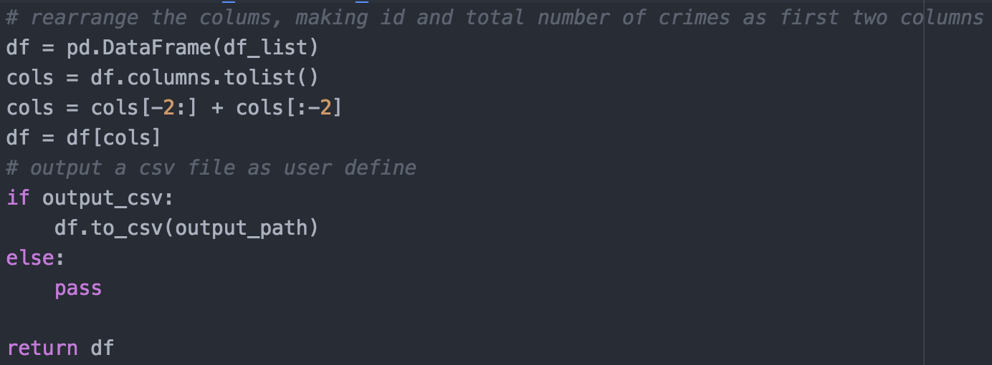
Crime Data Preprocessing: crime_info.py
Loop through 20k+ house data to generate the processed crime data

Slide 11
Merging Crime and Housing Datasets

Slide 12

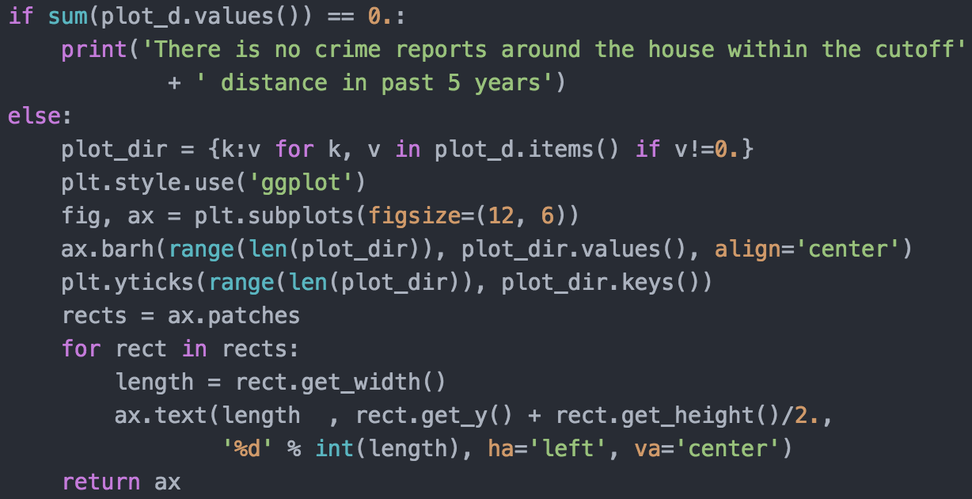
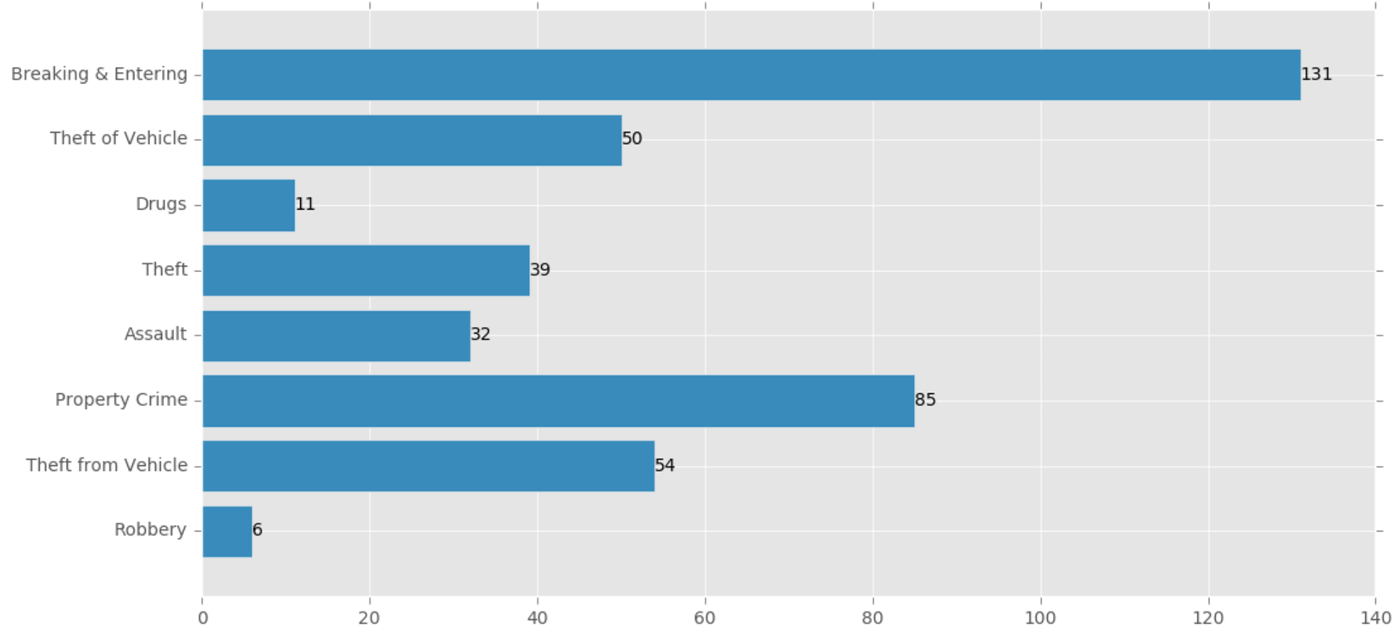
Crime Data Preprocessing: crime_info.py

Slide 13
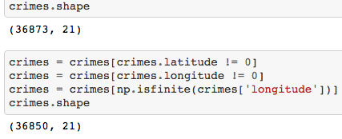
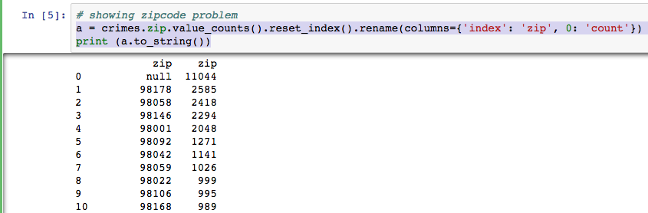
Zipcode Data Cleanup
Problems:
Longitude/Latitude Missing
Zipcode = “null” (Longitude/Latitude Available)

Slide 14
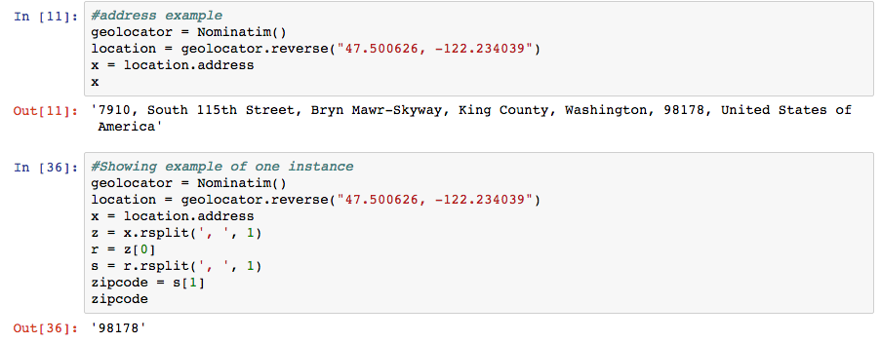
Zipcodes from Geopy Addresses

Slide 15
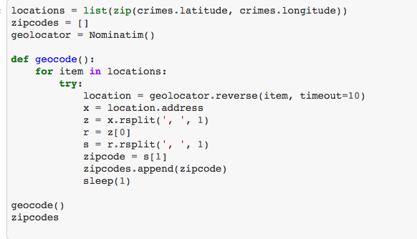
Zipcode Recursion with Geopy

Slide 16
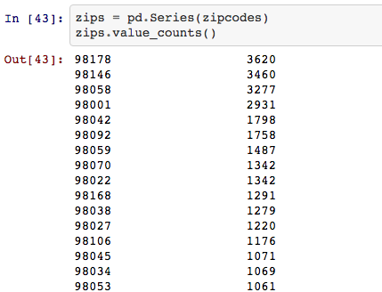
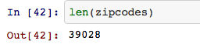
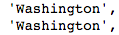
Zipcode Output (with errors)

Slide 17
Mapping Solutions
Package Focus: Folium, Geopy, Google Maps API

Slide 18
Google Street View API
The Google Street View Image API generates a street view photo from longitude/latitude coordinates.
The photo is defined with URL parameters in an HTTP request, and outputs in the form of a static image. (1)
Standard API Usage limits:
25000 requests per day
Size maximum: 640x640 pixels
Metadata responses in json format

Slide 19
Google SV API URL Parameters
Location
Latitude, Longitude (50 meter radius search for closest street view picture)
Size:
Defines pixel size output of image
Key:
Users are provided with a key that allows for 2500 free requests per 24 hrs.
Heading:
Compass heading of camera
fov:
Field of view in degrees (horizontal). Determines zoom (lower number = higher zoom)
Pitch:
Angle of camera in degrees.

Slide 20
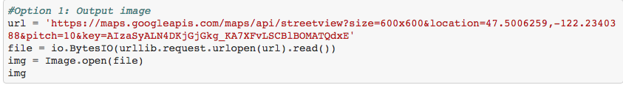
Images using Google Maps API

Slide 21
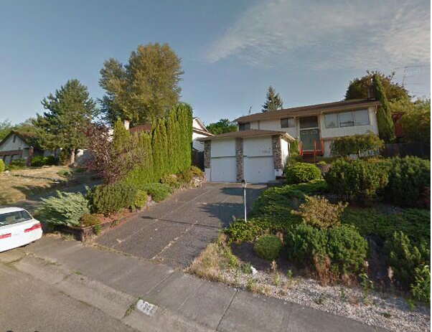

Slide 22
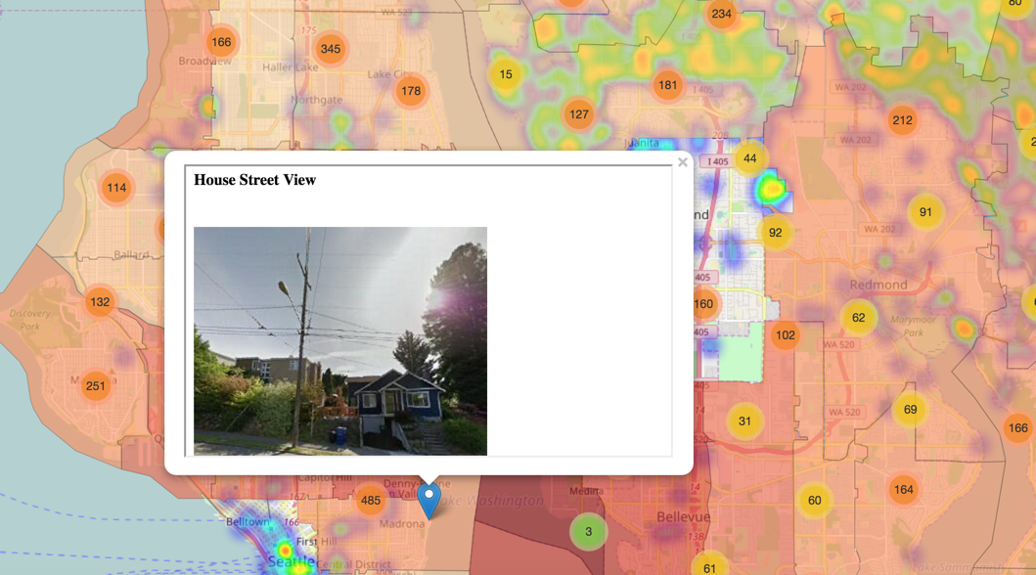
Layer 1
Interactive map with individual selectable markers:
Picture of house
House prices
House specifications (i.e. Bedrooms, square feet, year built, etc.)
Crime rate within 1-mile radius

Slide 23
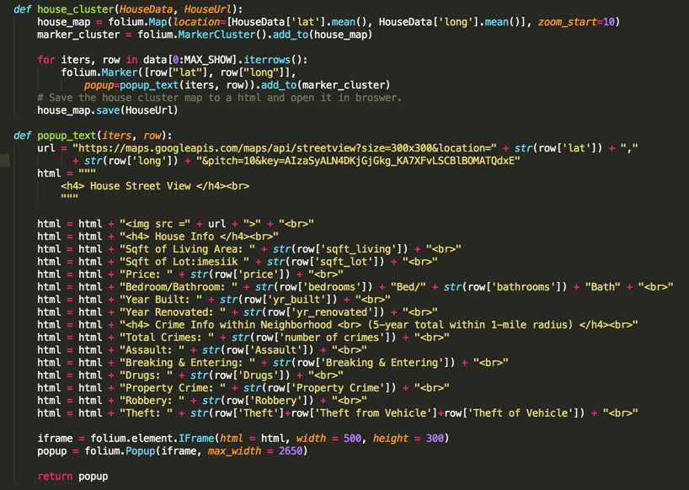
Markers w/ Popups
Marker
Folium.MarkerCluster
Location specified by GPS
Popup
Retrieve google street view via URL with GPS location
Text & photo loaded using html
Use IFrame to load html
Show IFrame in the popup

Slide 24
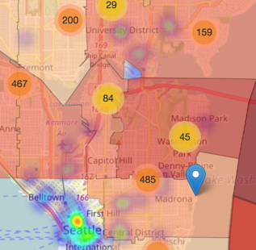
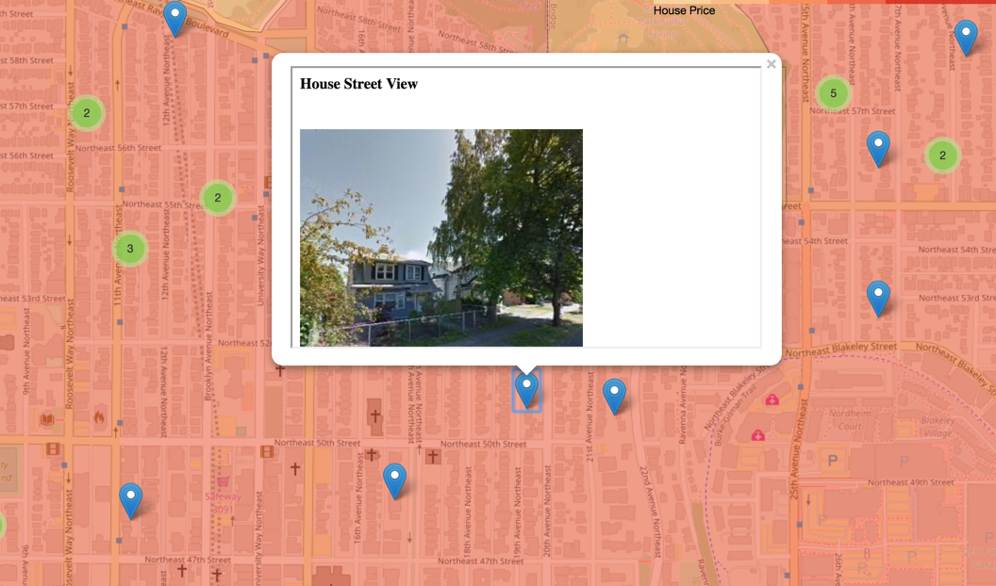
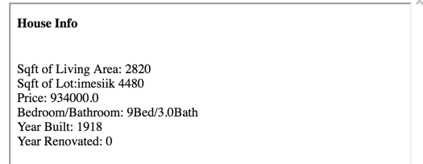
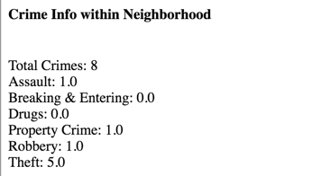
Interactive Map Rendering

Slide 25
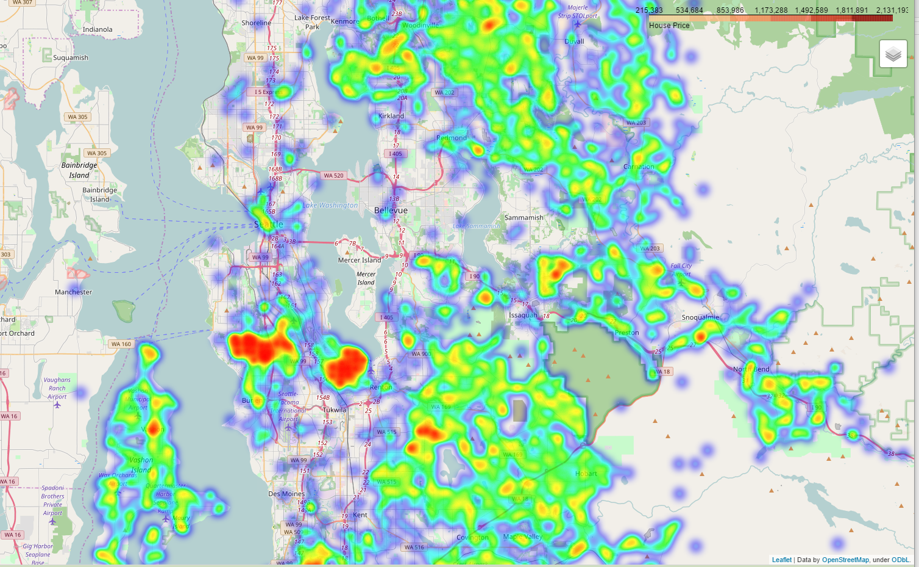
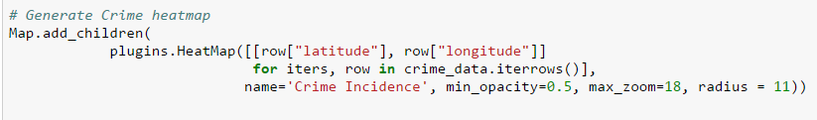
Layer 2
Heatmap of crime rates
Crime incidence viewed as heat map

Slide 26
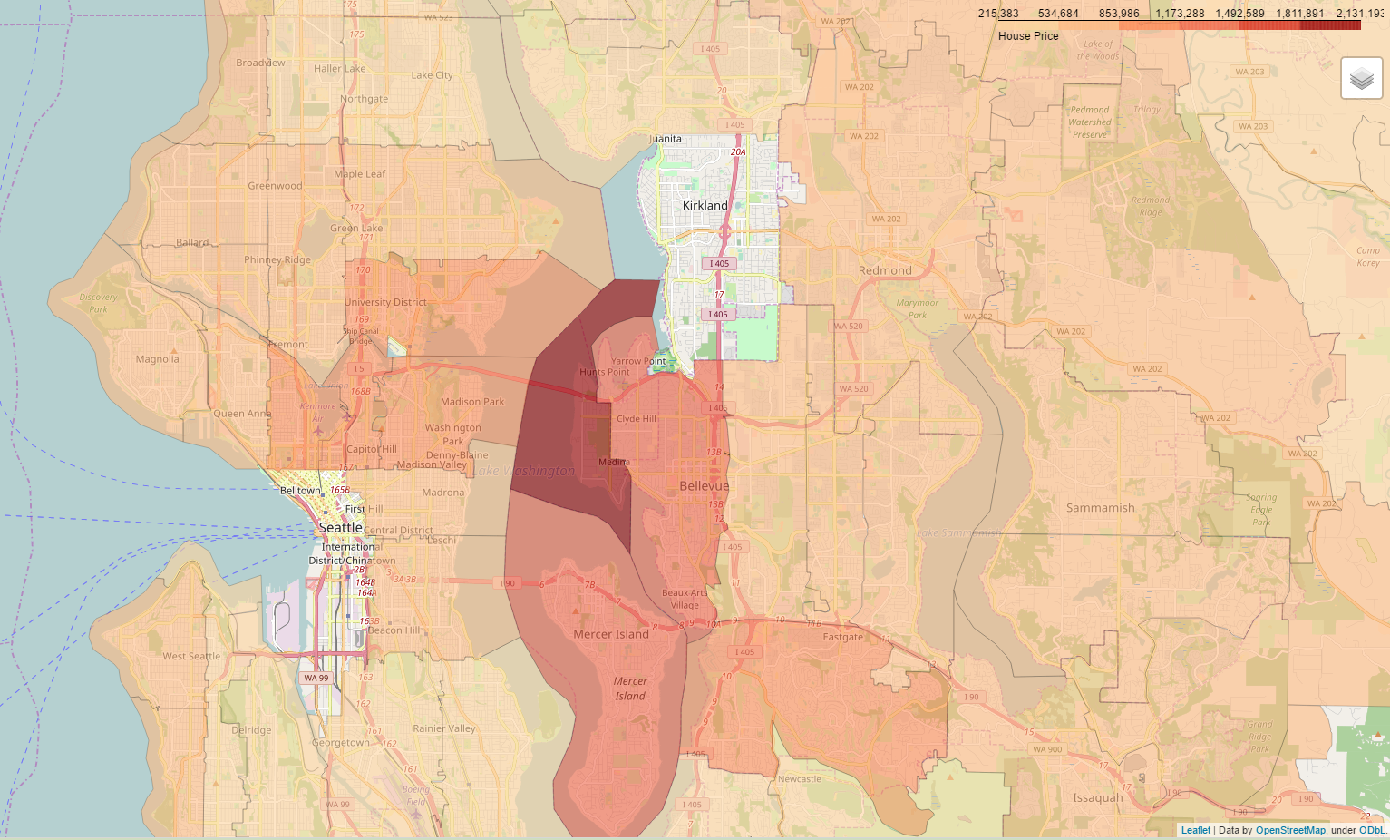
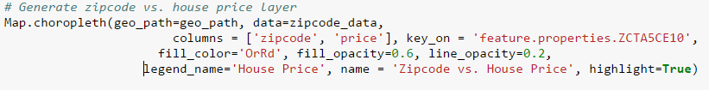
Layer 3
Average house price in each Zipcode
Choropleth map

Slide 27
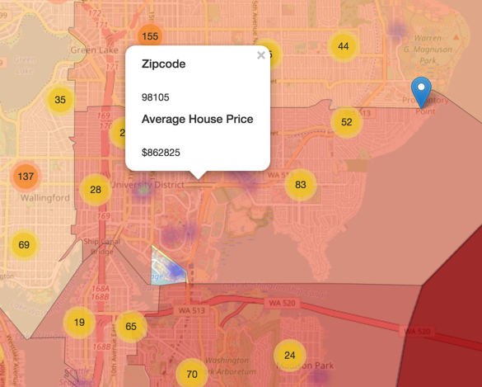
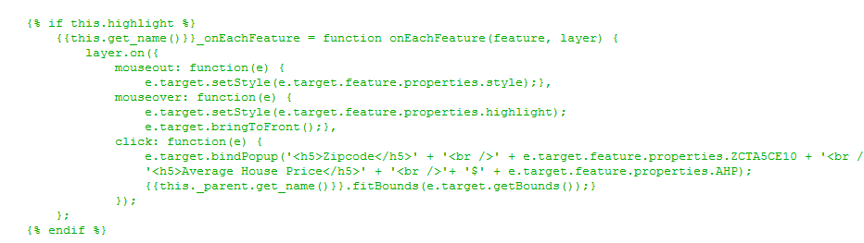
Average House Price per Zip Code
Changed source code in folium library

Slide 28
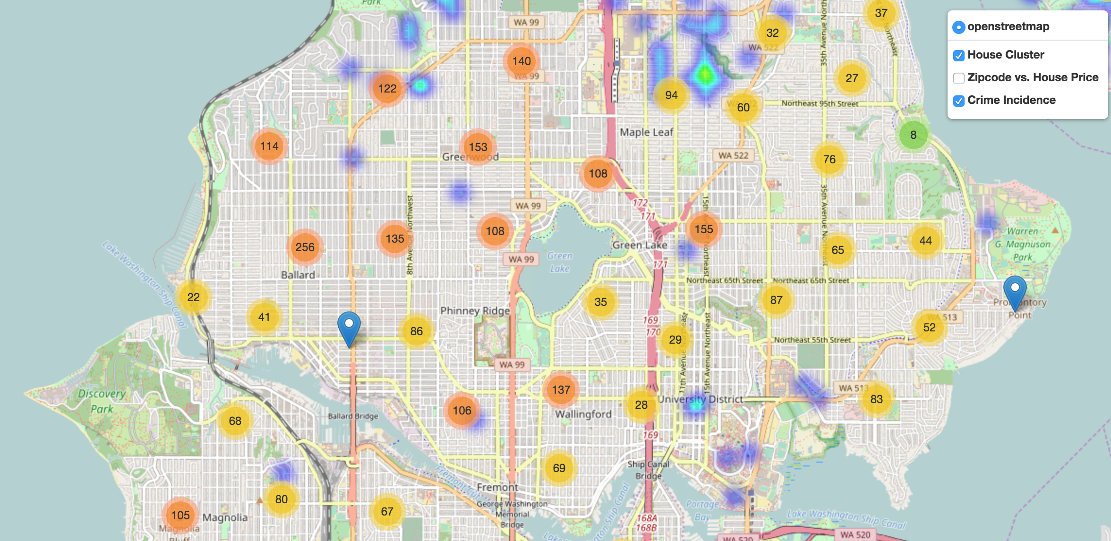
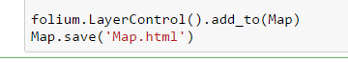
Map Layer Combinations & View Toggler
Simple with one line of code
Fix the source code to add layer name for choropleth layer

Slide 29
DEMO
Interactive Map of King County

Slide 30
Future Design Considerations
Analyzing correlations between types of crime, price, location etc.
Adjusting pictures if house is out of frame
Adding map layers to include other home purchasing factors such as:
Access to schools
Nearby entertainment options
Parking availability

Slide 31
Thank you!
Questions & Discussion

Slide 32
Sources
Google Maps APIs; Google Street View Apis; Developer’s Guide; https://developers.google.com/maps/documentation/streetview/
Folium; Folium 0.2.0 Documentation; https://folium.readthedocs.io/en/latest/

